Slide 1
Representativeness of Human Subjects in Chinese Psychological Research
贝冬丽 邓敏惠 邓远淇 郭泽敏 胡传鹏 季小童 李菲 李窈沙莹 汪浩远 叶金莲 岳磊 左西年
华中师范大学研究生会

Slide 2
后续计划
研究进展
方法
引言

Slide 3
01
引 言

Slide 4
Psychological science aims at understanding human mind and behaviour. However, psychological science largely relies on unrepresentative human samples: most human participants in published psychological studies are undergraduate students who take psychology courses from “Western, Educated, Industrialized, Rich, and Democratic” regions (Henrich et al., 2010a; Henrich et al., 2010b; Henry, 2008; Sears, 1986)
WEIRD
华中师范大学研究生会

Slide 5
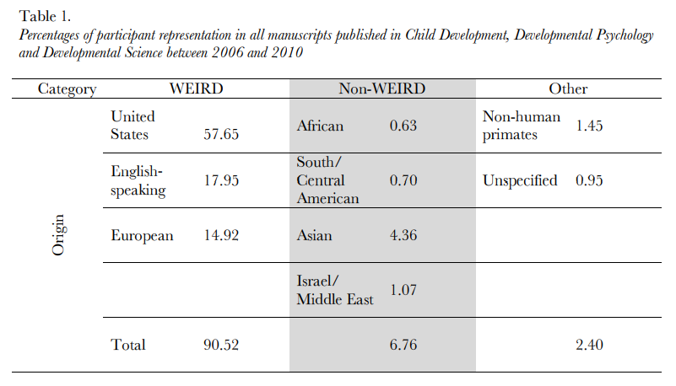
Nielsen et al., 2017
华中师范大学研究生会

Slide 6
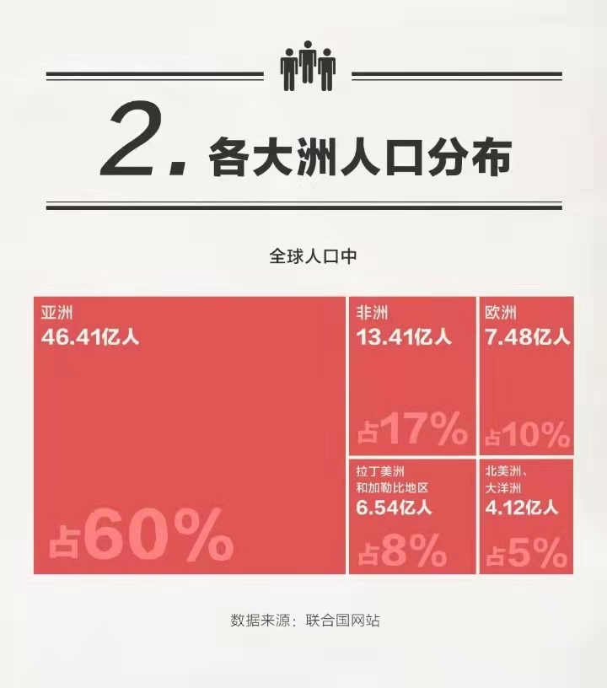
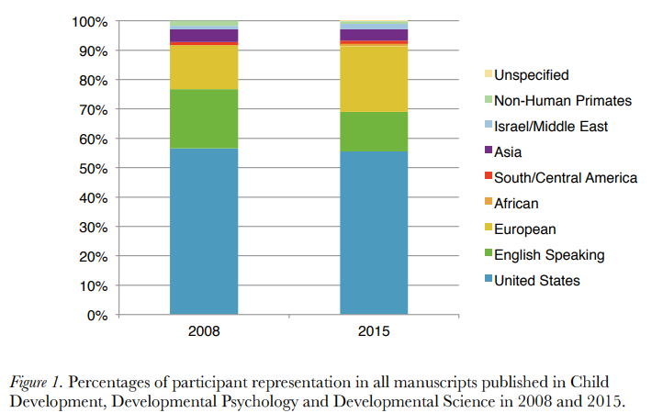
Nielsen et al., 2017
华中师范大学研究生会

Slide 7
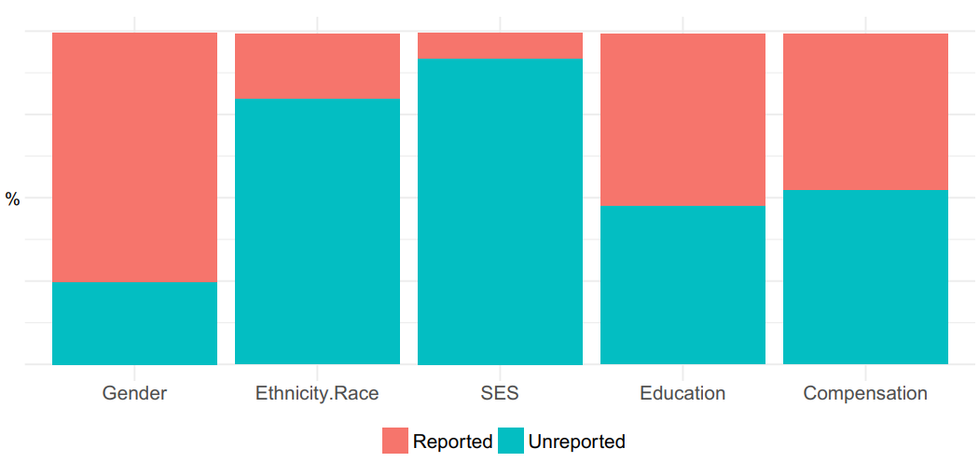
Rad et al. (2018)
华中师范大学研究生会

Slide 8
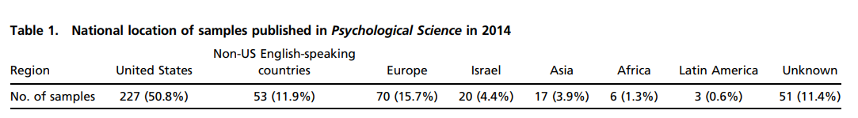
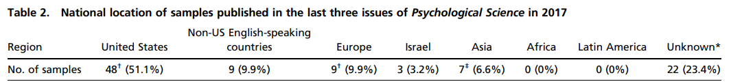
Rad et al. (2018)
华中师范大学研究生会

Slide 9
limiting our understanding of the whole picture of human mind and behaviour
WEIRD problem
leading to incorrect policies
华中师范大学研究生会

Slide 10
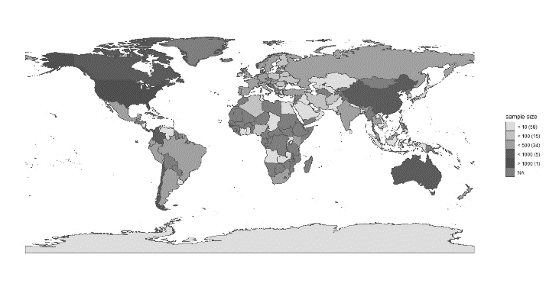
？
有代表性吗？
International collaborations projects
PSA
Human Penguin Project
Non_WEIRD data
Asia, Middle East,
Latin America, and Africa
华中师范大学研究生会

Slide 11
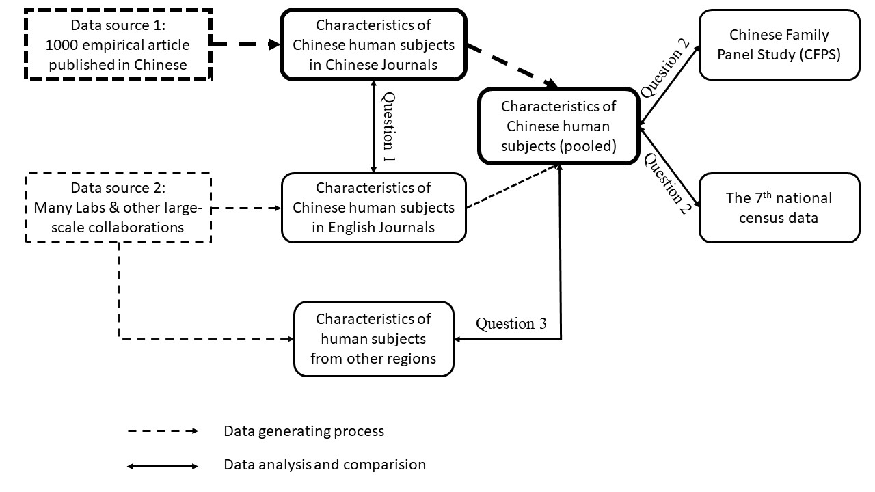
问题与假设
问题1：来自中国五大权威心理学期刊中的被试特征与来自国际合作项目中的中国被试特征是否相似？
相似
问题2：与人口普查数据和CFPS相比，心理学研究中的中国被试在多大程度上能代表中国人？
代表性差
问题3：其国家或地区被研究的对象是否和中国的被试有一样的特征？
Figure 1. Schema of the current meta-research.
是
华中师范大学研究生会

Slide 12
02
方 法

Slide 13
数据来源
中国临床心理学
心理学报
心理与行为研究
心理科学
心理发展与教育
Journal
...
Data source
International collaborations projects
华中师范大学研究生会

Slide 14
中国临床心理学
Wang et al. (2021)
2017~2018 500篇
心理学报
心理与行为研究
20081001
20081002
心理科学
心理学报
心理学报
心理发展与教育
...
2008 250篇
2020~2021 250篇
Journal
1000篇
Article number

Slide 15
20081001
20081001
20081002
20081002
R
20083053
20083053
20181053
20181053
20183053
20183053
Data code
20213053
20213053
Random sampling
Check

Slide 16
数据编码
Formal coding stage
pre-coding stage
Coding proofreading stage
华中师范大学研究生会

Slide 17
1
3
根据以往研究
制作编码手册
总结编码过程中的问题
（尤其是分歧）
2
5
4
至少两个研究者
进行试编码
再次进
行编码
完善编
码手册
6
无问题，编码手册制作完成
（预编码阶段结束）
华中师范大学研究生会

Slide 18
1000
Code manual
华中师范大学研究生会

Slide 19
……
……
……
……
……
R irr
paper
我来决定
华中师范大学研究生会

Slide 20
03
研 究 进 展

Slide 21
Q1
20081001
20081001
20081002
20081002
R
20083053
20083053
20181053
20181053
20183053
20183053
20213053
20213053
Random sampling
Check
Formal coding stage
pre-coding stage
Coding proofreading stage
华中师范大学研究生会

Slide 22
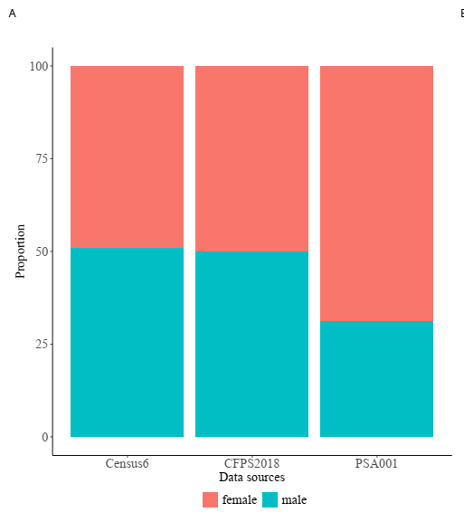
Q2
Figures 3. Preliminary results of the sex and age distribution from different data sources. (A) Sex ratio from the 6th census data, CFPS 2018 data, and psychological science sample (PSA 001’s data is used as an example); (B) Age distribution of the 6th census data the transparent barplot, and psychological science samples (PSA 001’s data as an example), the y-axis is age bins, the x-axis on the top is for the line plot of PSA 001 and x-axis on the bottom is for the pyramid plot of the 6th census data.
华中师范大学研究生会

Slide 23
Q2
Figure 3. Preliminary results of age distributions of psychological sample from different data sources, as compared with census data. Note that the x-axis on the top is for the line plots and x-axis on the bottom is for the population pyramid plot.
华中师范大学研究生会

Slide 24
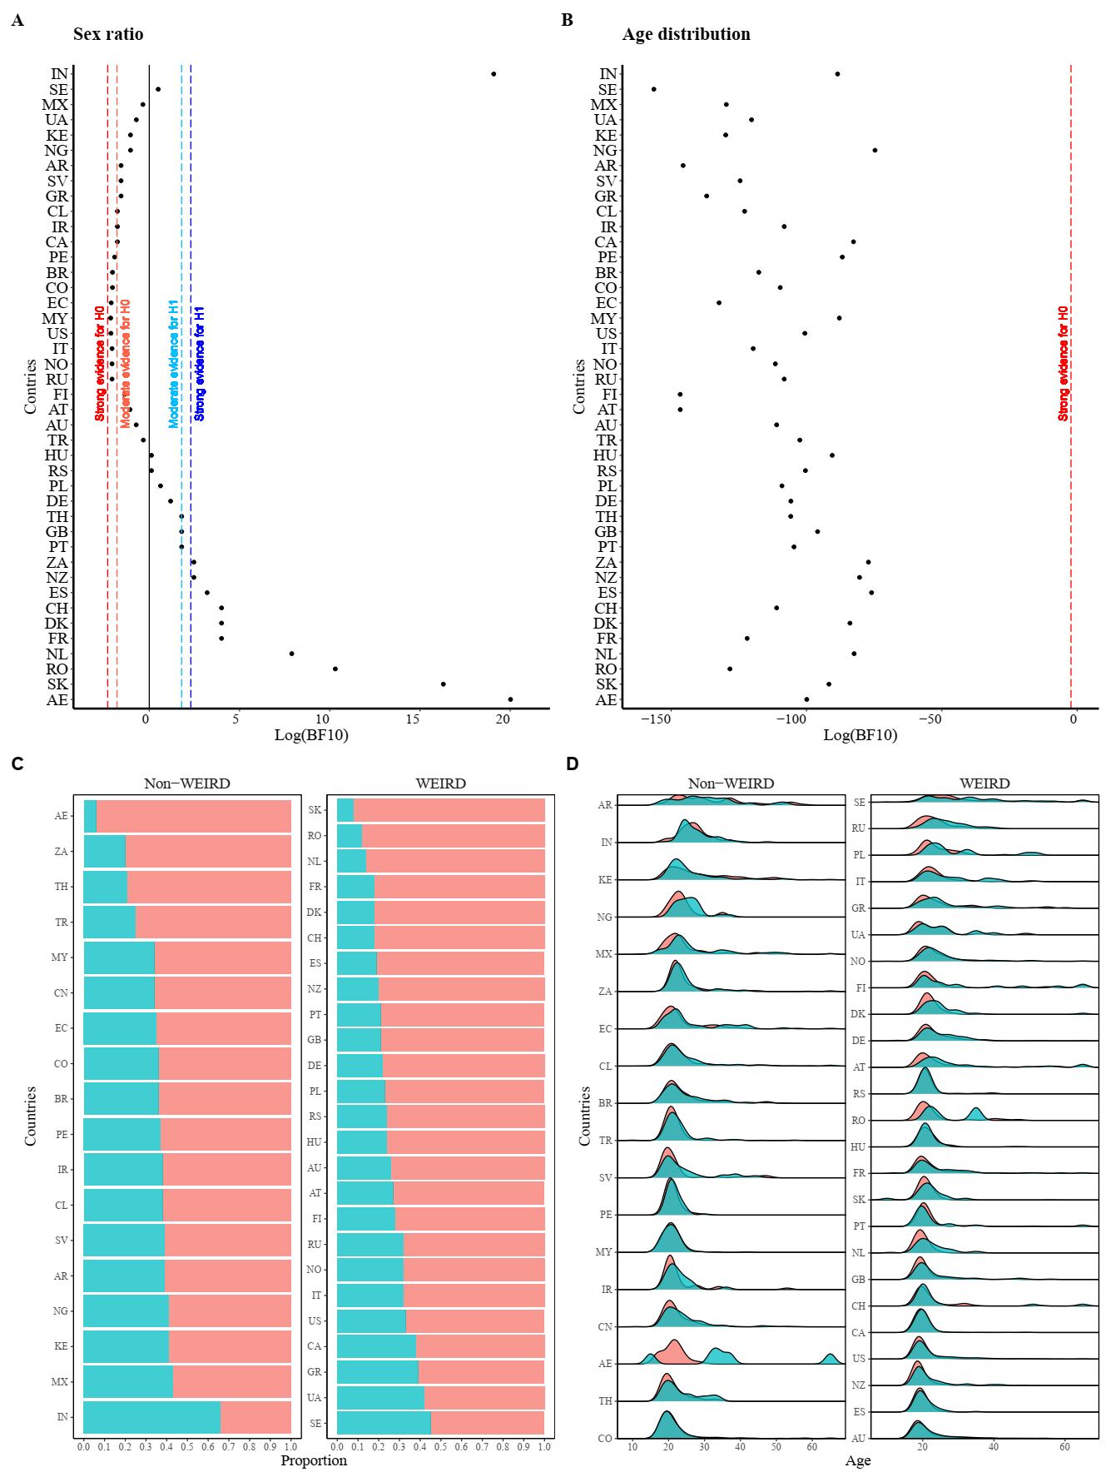
Q3
华中师范大学研究生会

Slide 25
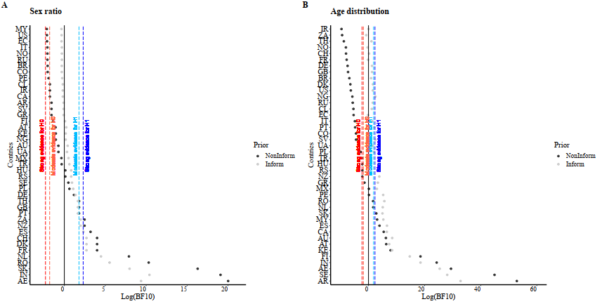
Q3
华中师范大学研究生会

Slide 26
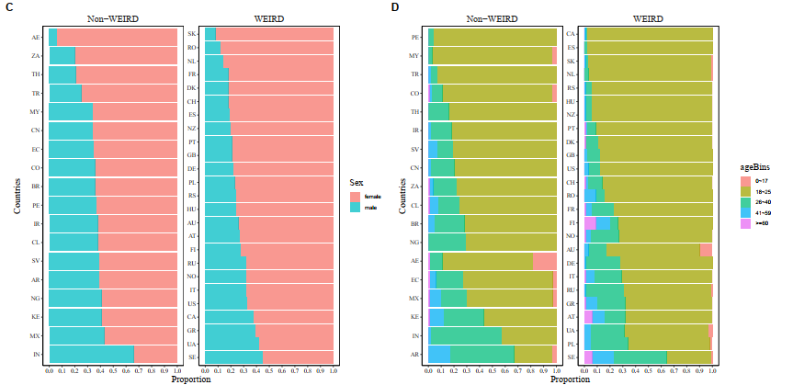
Q3
华中师范大学研究生会

Slide 27
03
后 续 计 划

Slide 28
PCI
...
data
华中师范大学研究生会

Slide 29
The Peer Community In (PCI) initiative is a non-profit, non-commercial platform that publishes the peer-reviews of preprints. The overarching aim of this researcher-run organisation is to create specific communities of researchers reviewing and recommending, for free, unpublished preprints in their field. PCI communities have so far been created across a wide range of sciences and are expanding rapidly. Once the submissions are accepted (or, in PCI terms, “recommended”) following peer review, the revised manuscript is posted at the preprint server where the preprint is hosted, and the peer reviews and recommendation of the preprint are posted at the PCI website. Authors then have the option to also publish the preprint in a traditional journal.
华中师范大学研究生会

Slide 30
PCI Registered Reports (PCI RR) is a new community dedicated to receiving, reviewing, and recommending Registered Reports (RRs) across the full spectrum of STEM, medicine, the social sciences and humanities. RRs are a form of empirical article in which study proposals are peer reviewed and pre-accepted before research is undertaken. By deciding which articles are published based on the question and proposed methods, RRs offer a remedy for a range of research biases, including publication bias and reporting bias.
华中师范大学研究生会

Slide 31
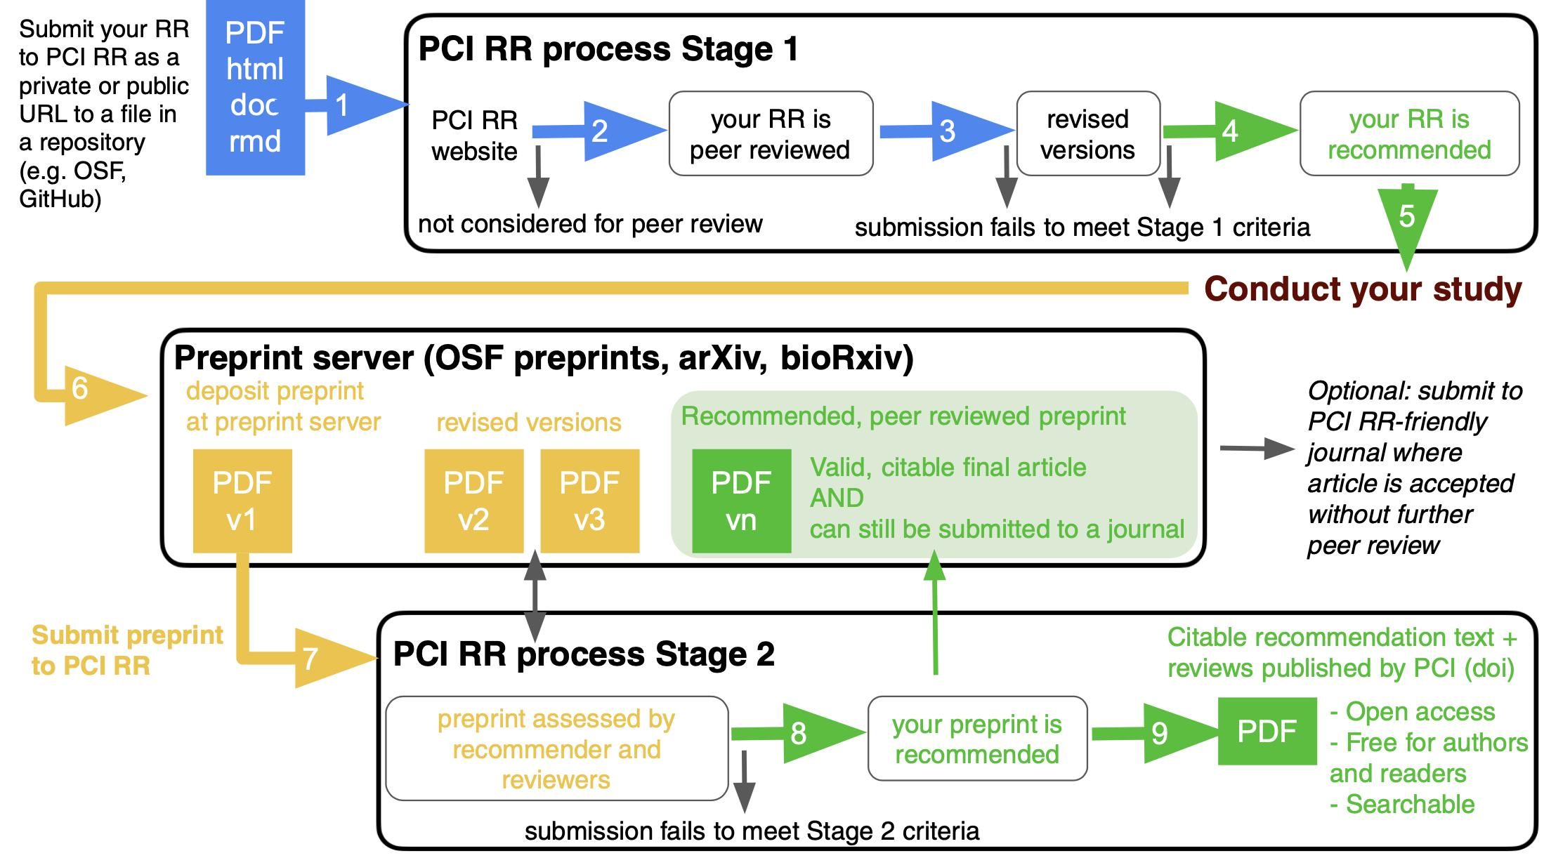
华中师范大学研究生会

Slide 32
R
analysis
Write paper
华中师范大学研究生会

Slide 33
感谢各位聆听！
感谢，感谢！

